Slide 1

Effects on the Popularity of Airbnb by NYC Borough
Arnold, Shifaa, Hayden, Shao

Slide 2

Key facts about your topic
Founded: 2008
Revenue: $2.60 Billion USD (2017)
Headquarters: San Francisco, CA
CEO: Brian Chesky
Founders: Brian Chesky, Joe Gebbia, Nathan Blecharczyk
A‌i‌r‌b‌n‌b‌,‌ ‌I‌n‌c‌.‌ is an online marketplace for arranging or offering lodging, primarily homestays, or tourism experiences. The company does not own any of the real estate listings, nor does it host events; it acts as a broker, receiving commissions from each booking. The company is based in San Francisco, California, United States.
Notes:
QuickStarter has created an outline to help you get started on your presentation. Some slides include information here in the notes to provide additional topics for you to research.

Slide 3
Contents
Who is using Airbnb in NYC?
How is Airbnb used in the different boroughs?
How do house building projects affect their Airbnb use?
Does crime have an impact on the Airbnb's use in different boroughs?
Is there a relation between hashtagged twitter data and the popularity of Airbnb in those areas?

Slide 4
The data exploration and cleanup process
#Check for duplicates abb_df.duplicated().sum()
0
#Check for Airbnb's availability for 2019 abb_df['availability_365'].value_counts().head()
0 17533 365 1295 364 491 1 408 361
#Drop Airbnb's with no availability for 2019 unavail_abb_df = abb_df[abb_df['availability_365']==0] clean_abb_df = abb_df[abb_d f['availability_365']>0] len(clean_abb_df)
31362

Slide 5
Data Cleanup
Checked for duplicates
Removed Airbnb’s with 0 availability
Checked for null values
No null values in columns we deemed as significant
Checked data types for each column
Renamed all the columns

Slide 6
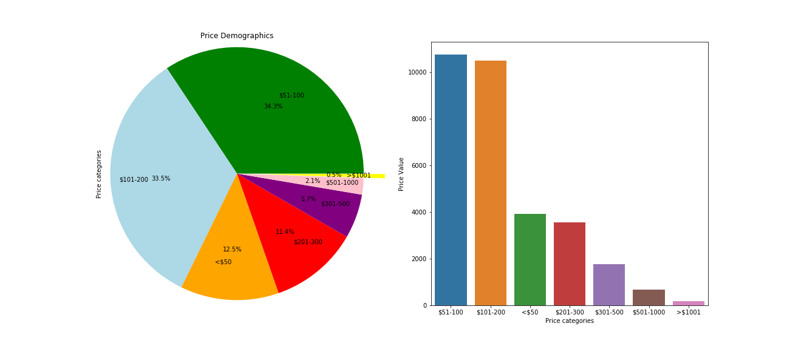
Who is using Airbnb in NYC ?
Minimum Price | Maximum Price | Mean
$0 | $10000 | $162.05

Slide 7
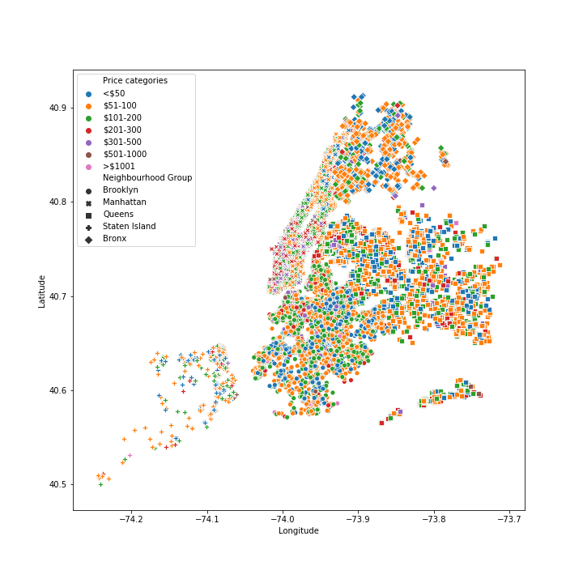

Slide 8
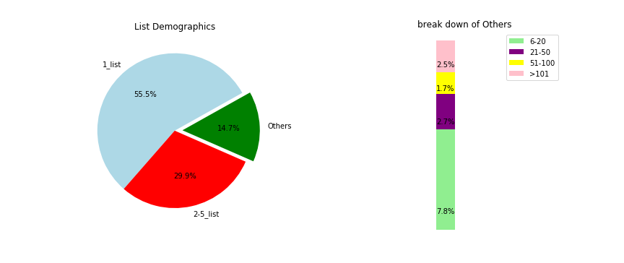

Slide 9
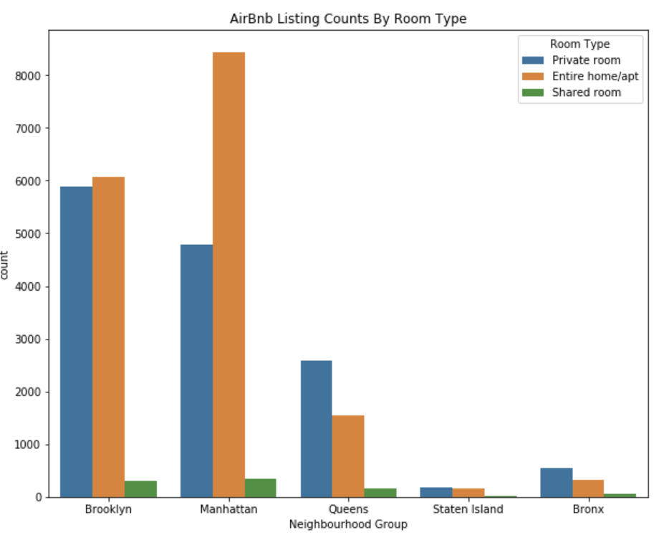
How is Airbnb used in the different boroughs?

Slide 10
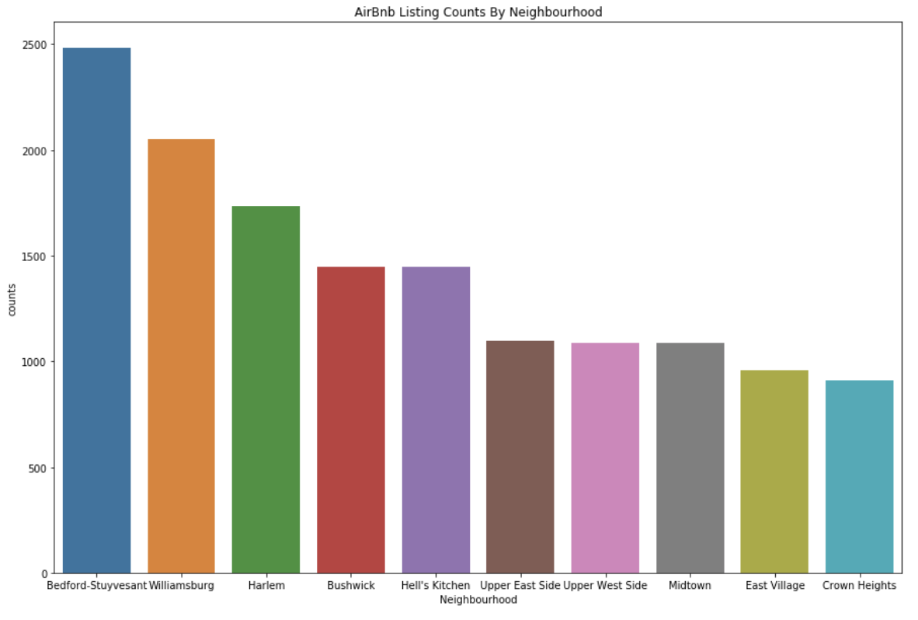

Slide 11
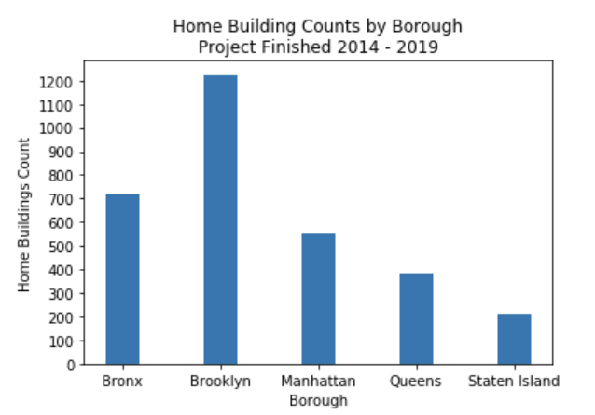
How do house building projects affect Airbnb listings?

Slide 12
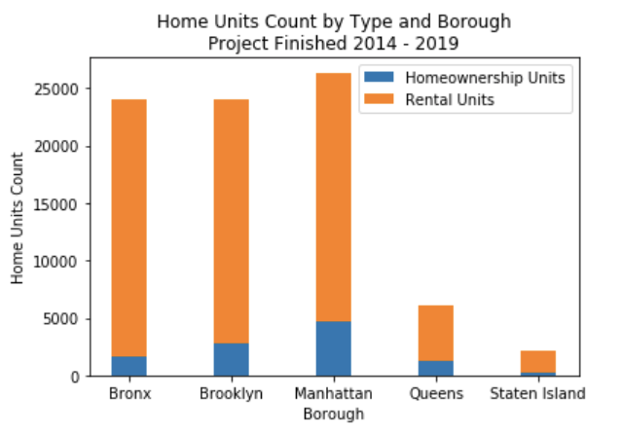

Slide 13
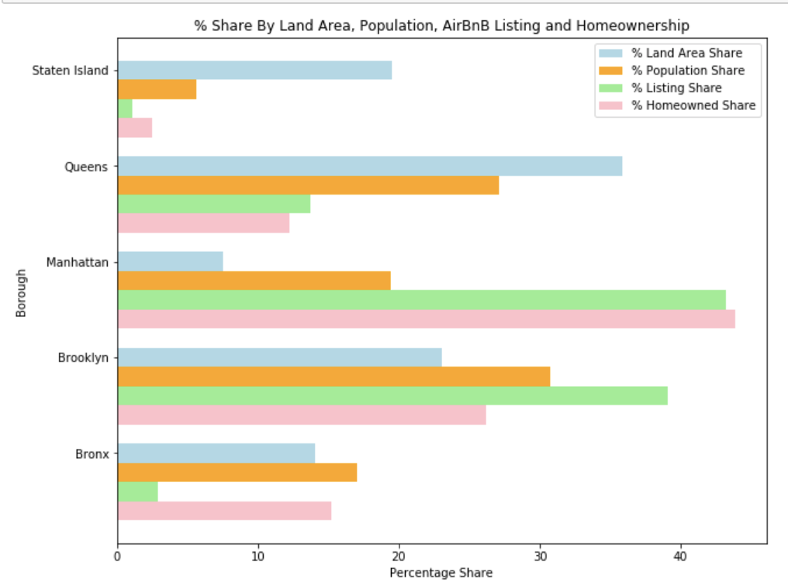

Slide 14
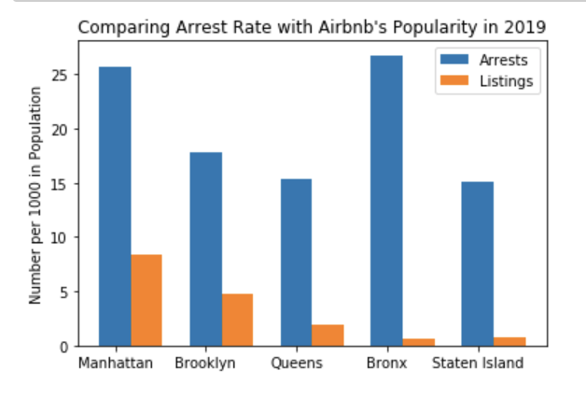
Does crime have an impact on the Airbnb's use in different boroughs?

Slide 15
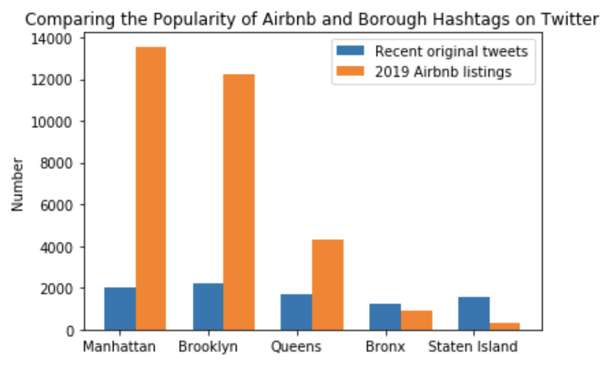
Is there a relation between hashtagged twitter data and the popularity of Airbnb in those areas?

Slide 16
Discussion
We found that Manhattan has the highest number of Airbnb listings followed by Brooklyn
There is a correlation of the high number of new home units with the high number of AirBnb listings in Manhattan, Brooklyn and Queens.
As the arrest rate decreases, the frequency of Airbnb listings also seems to decrease. This held true for four of five boroughs
Manhattan and Brooklyn had far more Airbnb listings, but their borough names did not get used as a hashtags any significant amount more.

Slide 17
Post Mortem
We wanted to see if points of interest or tourist landmarks would have an impact on Airbnb popularity but we did not have enough time and could not find any data for this
We could not find a trend in our data or link it to a cause.
We would have liked to examine Airbnb trends in more detail by neighborhood to get a better representation
We would have also liked to do a price comparison with hotels and other facilities in the area.
We struggled with the repository and merging our work through github

Slide 18

Works cited
2019 New York Airbnb Open Data (CSV) -
https://www.kaggle.com/dgomonov/new-
york-city-airbnb-open-data
NYC Population by Neighbourhood (CSV)-
https://data.cityofnewyork.us/City-
Government/New-York-City-Population-By-Neighborhood-Tabulatio/swpk-hqdp
Demographic and Housing Profiles by Borough (CSV) -
https://data.cityofnewyork.us/City-Government/Demographic-and-Housing-Profiles-
by-Borough/cu9u-3r5e
NYPD Arrest Data (Year-to-Date) (CSV) -
https://data.cityofnewyork.us/Public-
Safety/NYPD-Arrest-Data-Year-to-Date-/uip8-fykc
Tweepy (API)

